Slide 1
Software Maintenance: A DevOps Practitioners Perspective
Rafed Muhammad Yasir

Slide 2
Today We Will Discuss
What is DevOps
What is the DevOps lifecycle
Fundamentals of code maintenance: Git branching strategies
Production maintenance: Observability

Slide 3
DevOps is the combination of cultural philosophies, practices, and tools that increases an organization’s ability to deliver applications and services at high velocity

Slide 4
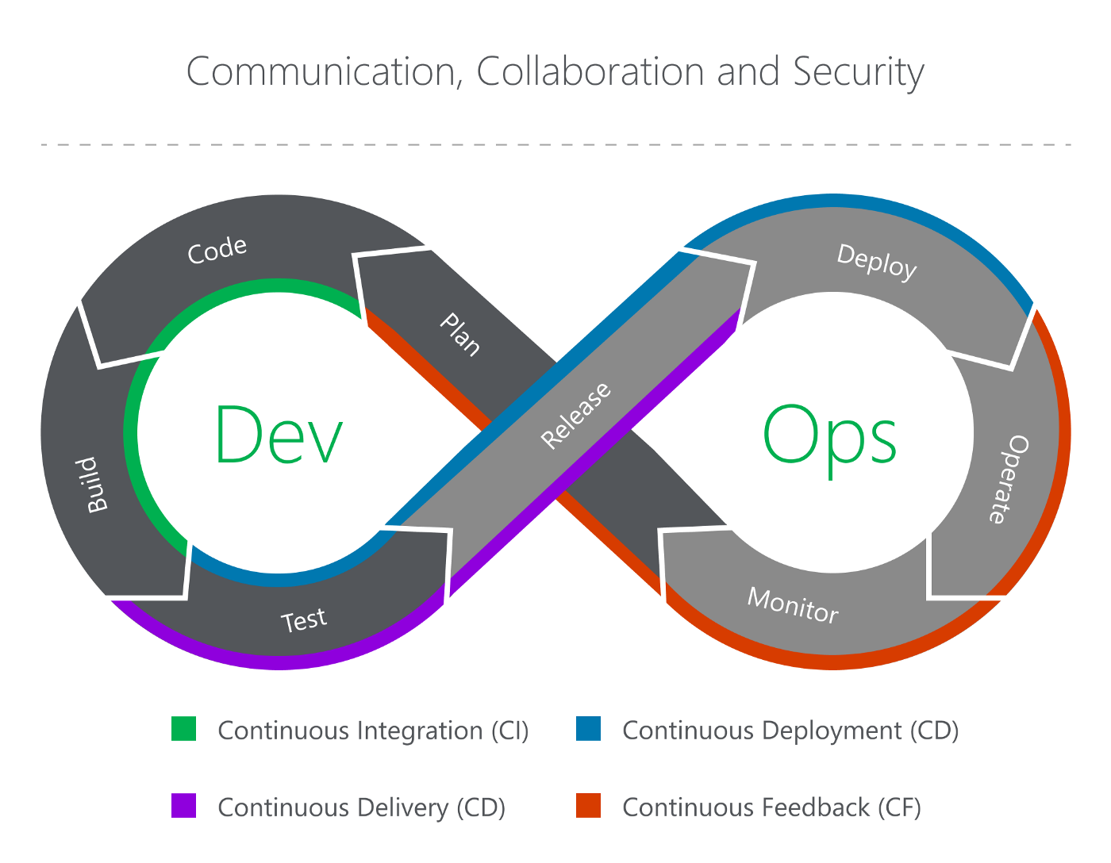
The DevOps Lifecycle

Slide 5
The DevOps Lifecycle: Continuous Everything!

Slide 6
Git Branching Strategies
1. Github flow
2. Git flow
3. Trunk-based development

Slide 7
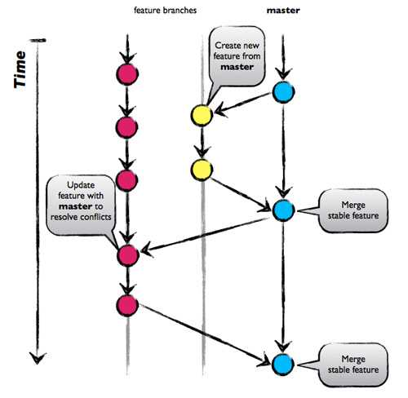
1. Github Flow

Slide 8

2. Git Flow

Slide 9
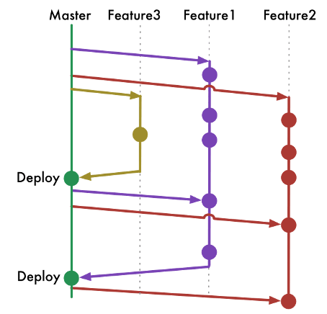
3. Trunk-based Development

Slide 10
Production maintenance: Observability
Observability is the ability to measure the state of a system by examining its outputs. A system is considered “observable” if the current state can be estimated by only using information from outputs, namely sensor data.
The three pillars are observability are:
Metrics
Logs
Traces
In short known as MLT. Another popular version is MALT (MLT with Alerts)

Slide 11
MLT Observability: Metrics
How much CPU is being utilized?
Is the RAM full?
How much disk space is used?
How many times did a process crash/restart?
How many users are accessing the system?
Are there non 20X responses? (40X, 50X)

Slide 12
MLT Observability: Logs
Record exceptions
Common log levels:
DEBUG
INFO
WARN
ERROR
CRITICAL

Slide 13
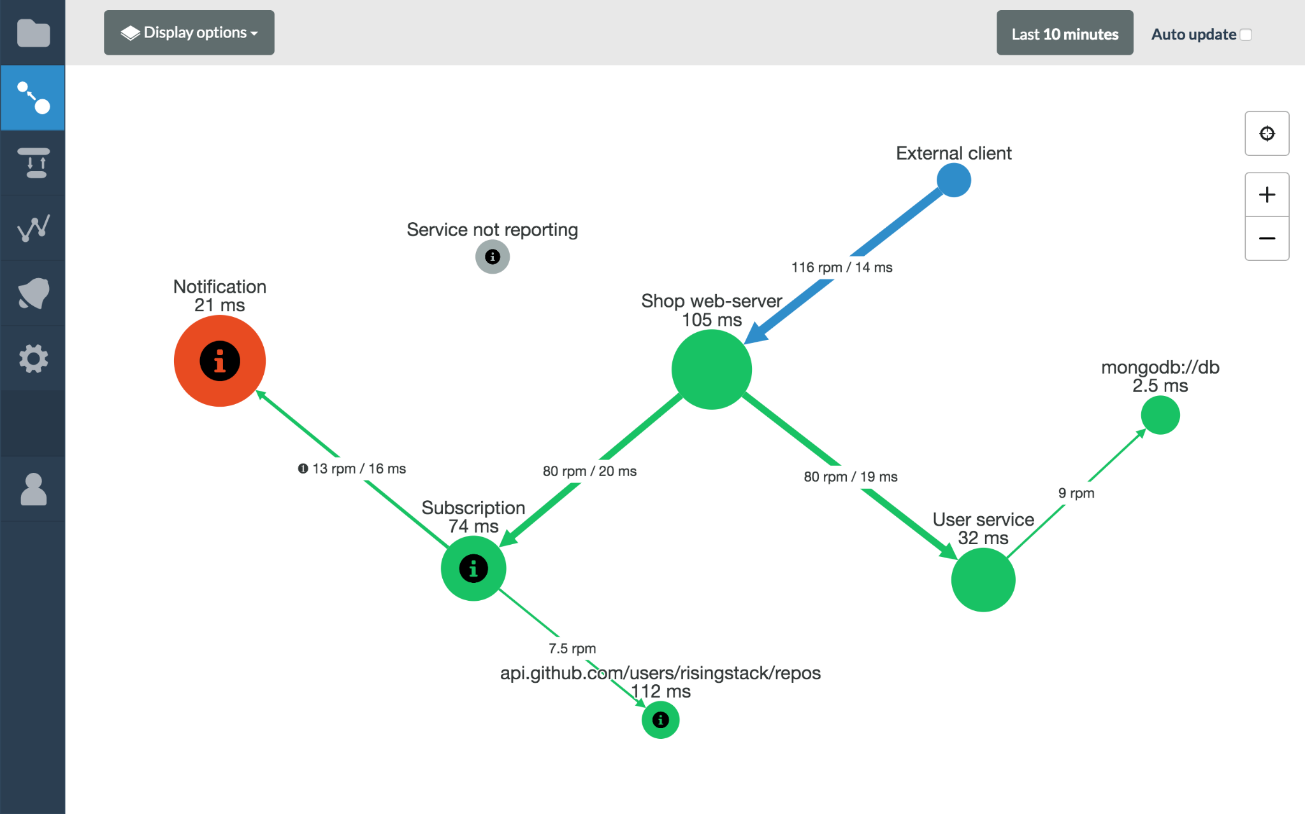
MLT Observability: Tracing

Slide 14
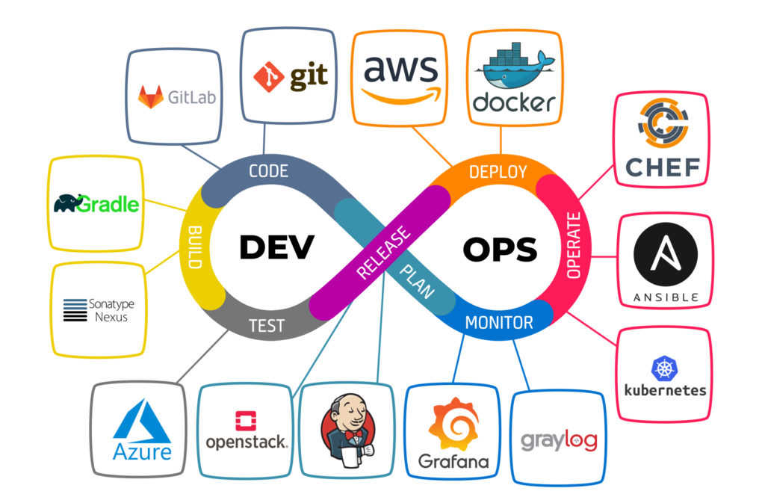
The Heart of DevOps is Automation

Slide 15
Thanks Everyone!

